Slide 1
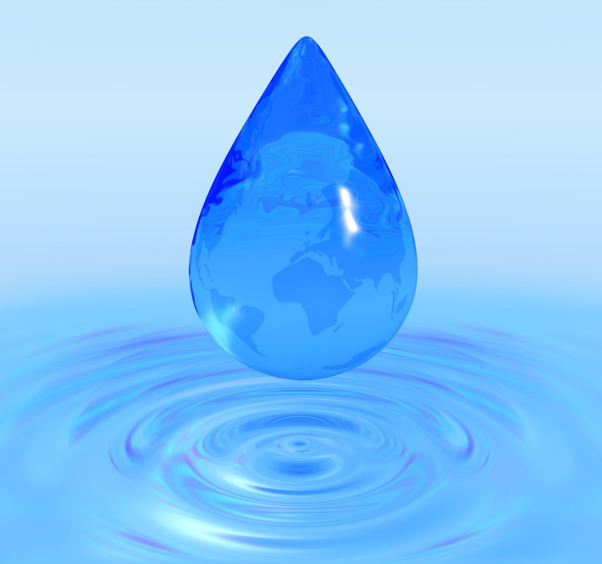
Rain Water Harvesting
Presented By:
Disha Ghosh
Anindita Jana
Stuti Das
Ananya Mukherjee
Swarnali Chattopadhyaya

Slide 2
What is rain water Harvesting?
Rainwater harvesting is the accumulation and deposition of rainwater for reuse on site , rather than allowing it to run off.

Slide 3
Uses of rain water
Recharge under ground water.
Gardening.
Livestock.
Drinking purpose.
for irrigation purpose.

Slide 4
Advantage
Simple to install and operate
Running cost is negligible
Quality is acceptable for domestic purpose.

Slide 5
How can we harvest rainwater?
Surface run-off harvesting
Roof top rainwater harvesting.

Slide 6
Components of the roof top rainwater harvesting system
Catchment area
Storage System
Delivery system
Filtration system

Slide 7
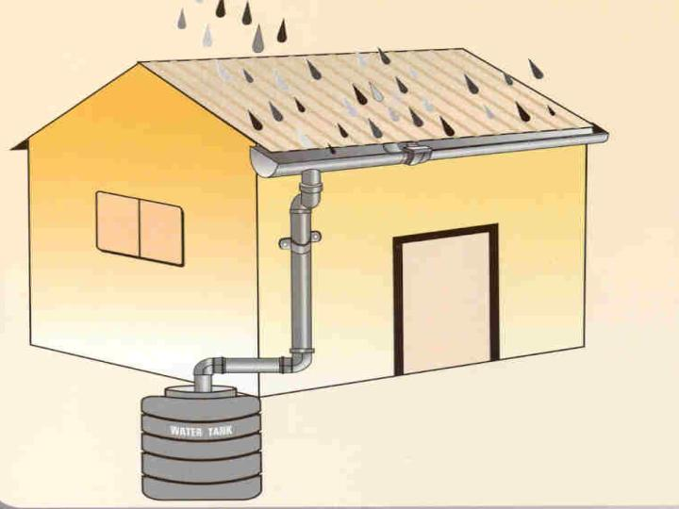
Catchment area
The surface that receives rainfall directly is the catchment of rainwater harvesting system.It may be terrace, courtyard or open ground.

Slide 8
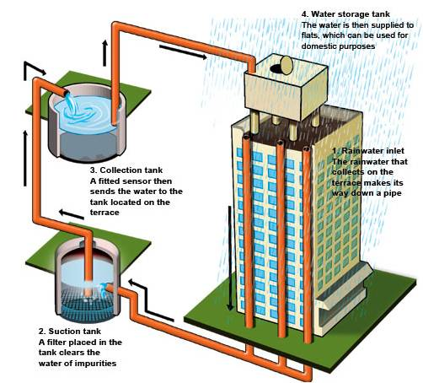
Storage System
All collected rain water are stored in tanks

Slide 9
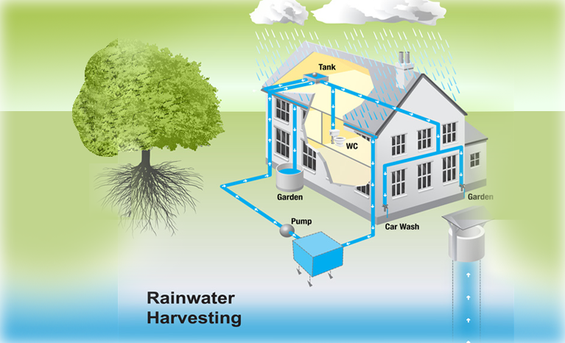
Delivery System
System to deliver water for uses. There are pumps to take out water from tanks and use it for purposes.

Slide 10
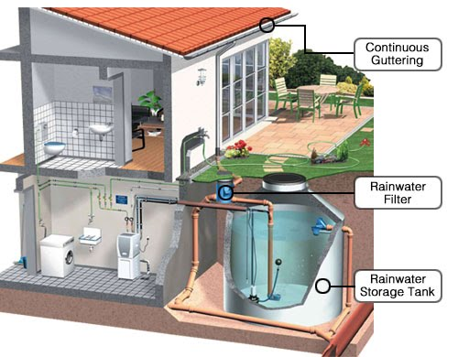
Filtration System
Filter are used for treatment of water properly. Filtration purifies the water and make it fit for drinking and other uses.

Slide 11
Recharging ground water aquifers
Recharging of bore wells.
Recharging of dugs wells.
Recharge pits.
Recharge Trenches.
Percolation Tanks.

Slide 12
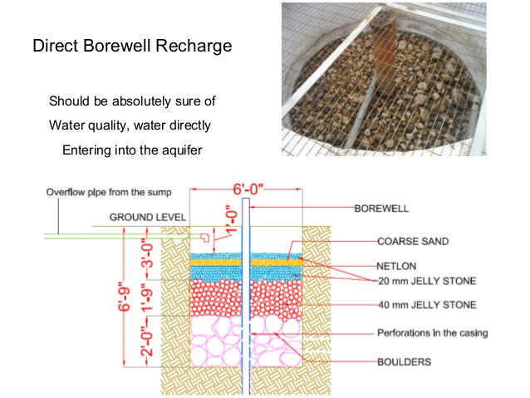
Recharging of bore wells

Slide 13
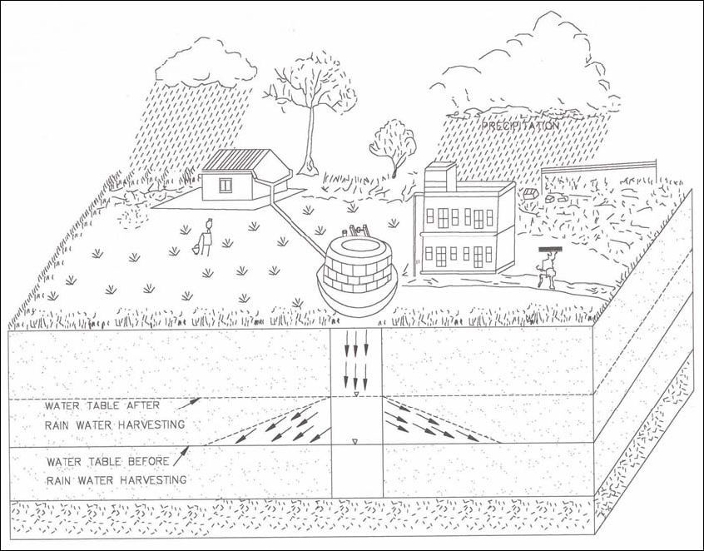
Recharging of dugs wells

Slide 14
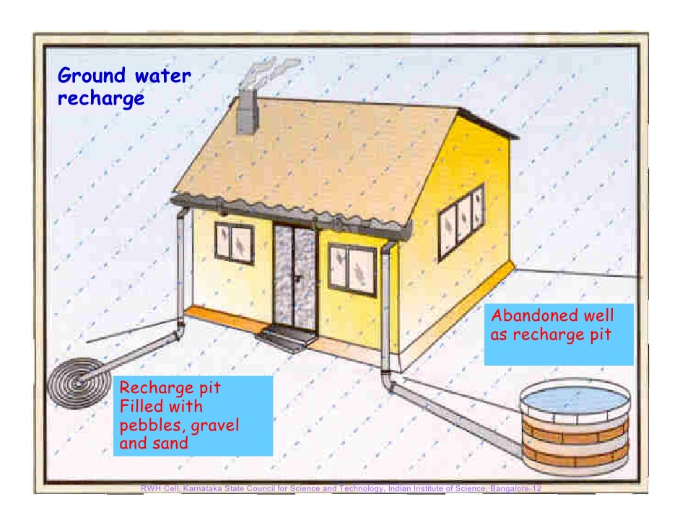
Recharge pits

Slide 15
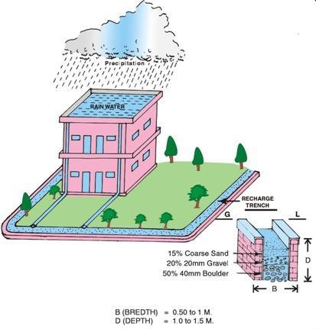
Recharge Trenches

Slide 16
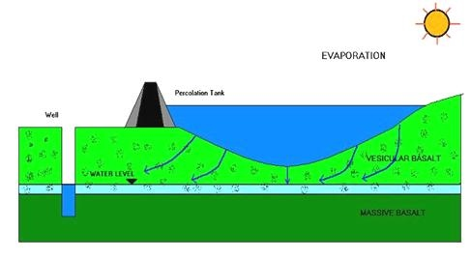
Percolation Tanks

Slide 17
Why do people harvest rainwater?
To inculcate a culture of water conservation.
To reduce soil erosion.
Reduces impact on environment.
It can provide 50% of family’s water need.

